Slide 1
In the name of God

Slide 2

Chronic Disease Care

Slide 3
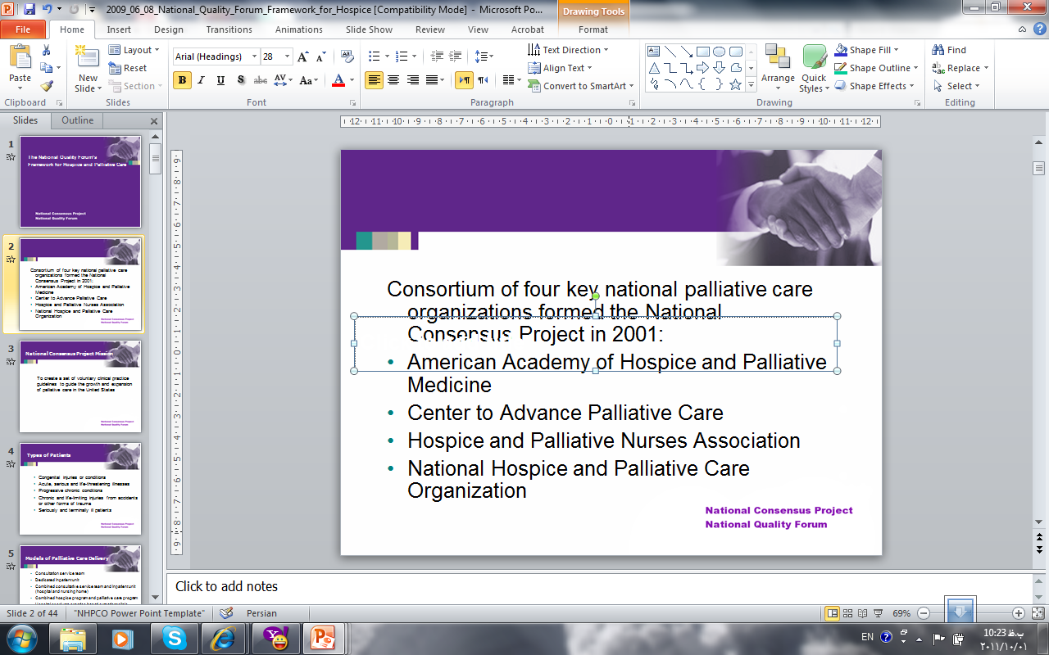

خوشبختي مهمترين انگيزه براي تلاش و حركت تمامي انسانها در زندگي است و تصورخوشبختي درذهن افراد با تمامي تفاوتها دردو موضوع سلامت وشادي مشترك است.

Slide 4
In World
W H O
Heart Disease ,Brain Stoke , COPD are the leading cause of death worldwide.
about 57million people worldwide died
Globally, non-communicable diseases, 63% of all deaths in the world are included.
No communicable diseases cause two-thirds of all deaths worldwide in 2011 were.
80% of deaths from these diseases in poor or middle-income countries occurs

Slide 5
In Iran
24% of deaths in people under 60 years make up.
The World Health Organization estimates that 72 percent of all deaths due no communicable diseases is in Iran.
70 thousand people a year in the country due to cancer patients, and 30 thousand people die from cancer.
Cardiovascular disease, 47% of deaths in Iran.
20% of the population are over 20 years old with high blood pressure

Slide 6
Definition of chronic disease:
The disease is chronic, long-term physical changes in the body and functions to limit the patient returns.

Slide 7
Chronic Diseases
Continual
Disability
Treatment
Care
Education

Slide 8
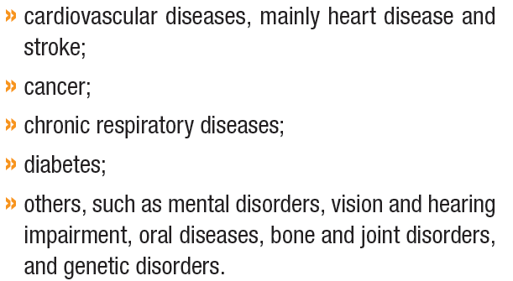

What are Chronic Diseases?

Slide 9
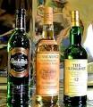


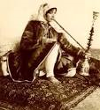

Risk of factor
Smoke
Alcohol
Life style
Stress
Environmental

Slide 10
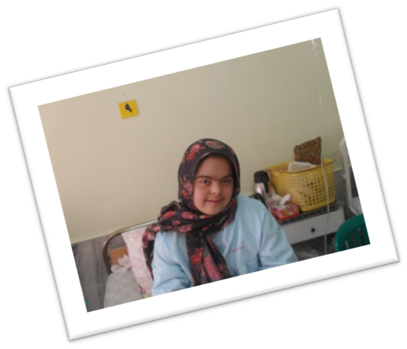
False beliefs
Rich
Elderly
Sex
Non-preventable
High Cost
Notes:
درمان هزینه بردار نیست

Slide 11
Disorders and complications from chronic diseases
Physical problems
Depression
Anger
Feelings of guilt
Suicide
Sleep disorders
Impaired appetite
Sexual Dysfunction
Addiction
Shock
Speech and language disorders
Denial of illness
Disorder
Personality change
Notes:
5- اختلال شناحتی

Slide 12
Guidelines
Weight Control
Hypotension
Lower Cholesterol
Prevention of myocardial infarction
Strengthening the immune system
Nutrition
Cancer Prevention
Notes:
2- پرت کردن حواس

Slide 13
Guidelines
Acceptable condition
Accept treatment
Counseling and Psychotherapy
Social support networks
Individual activities, employment and social
Religious teachings
Muscle relaxation
Exercise and physical activity
Recreation, Entertainment
Lifestyle changes
Control of disease conditions
Avoid Stress
Acceptance of Death

Slide 14
Families and caregivers of patients with chronic physical health

Slide 15
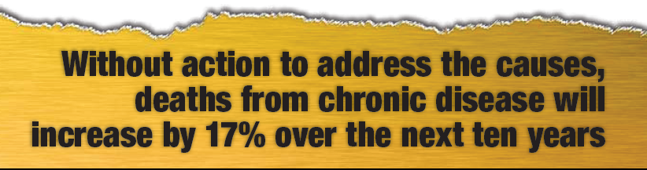

Slide 16

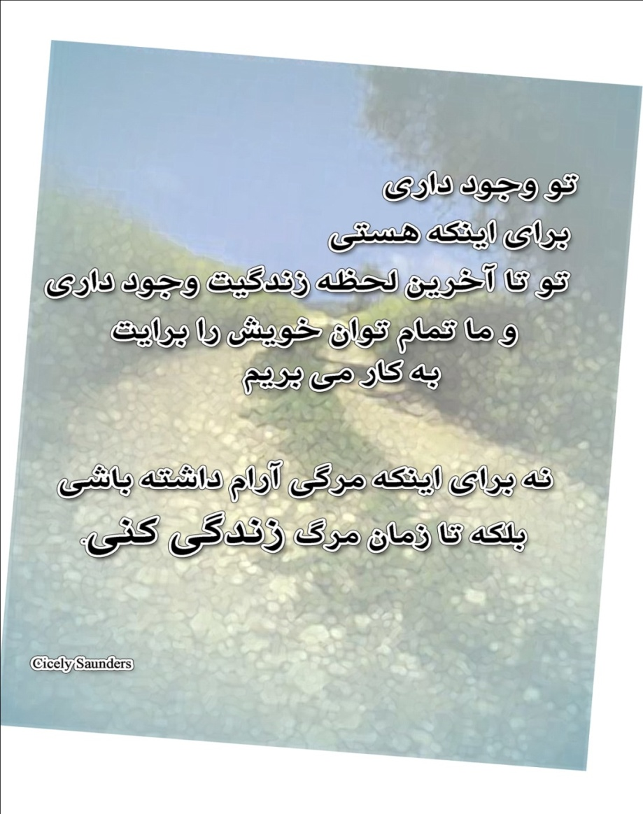
با تشکر ازحسن توجه شما
N

